Slide 1
IPM Makes Sense!
Florida’s Certified Crop Advisors
Norm Leppla, Director
UF/IFAS Statewide IPM Program

Slide 2
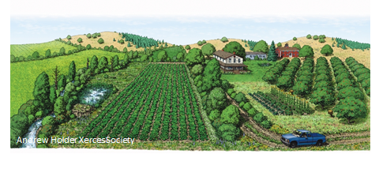
IPM Concepts and Resources
Why do we have insect pest problems?
How does integrated pest management work?
IPM in pesticide resistance management
IPM resources available in Florida

Slide 3
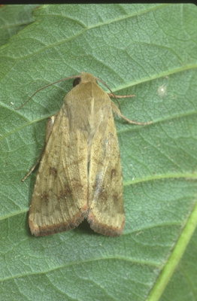
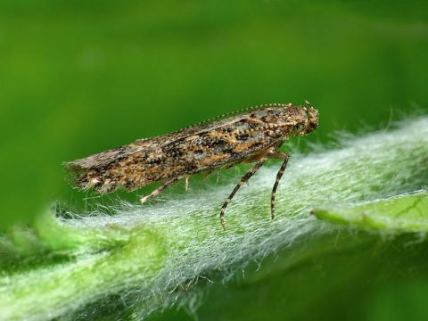
Current Situation
Over the past 30 years, new species have been added to Florida’s fauna at a rate of about one per month (Frank and McCoy 1992).
How do we prevent or manage these invasions
?
Tuta absoluta
Old World Bollworm

Slide 4
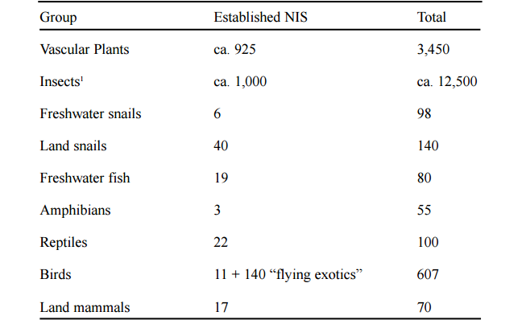
Estimated Numbers of Non-Indigenous Species in Florida
Klassen et al. 2002, Frank and McCoy, 1995a,b

Slide 6
Records 1970-1989 Frank, & McCoy 1992
Records 1990-2015 FDACS-DPI sample submission database

Slide 7
Records 1970-1989 Frank, & McCoy 1992
Records 1990-2015 FDACS-DPI sample submission database

Slide 8
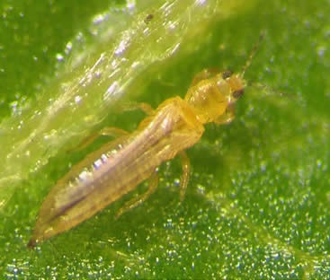
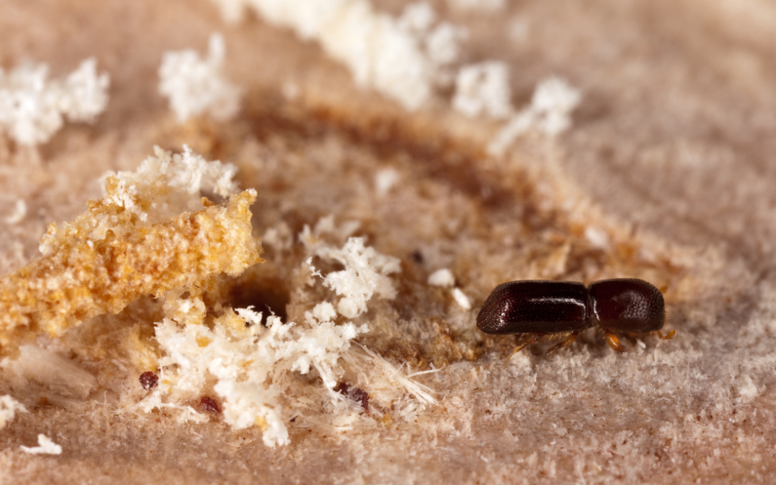
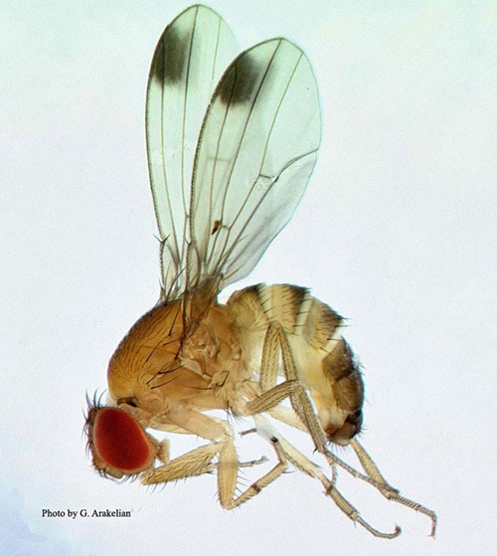
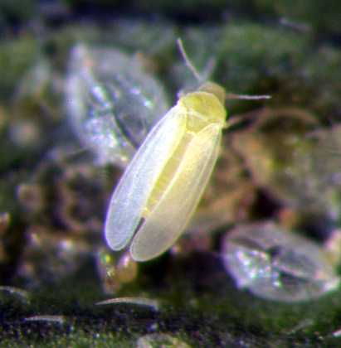
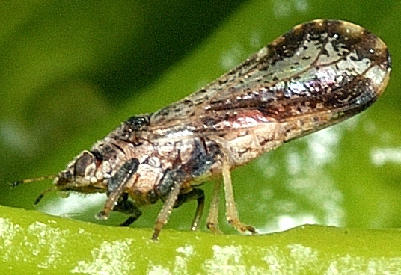
David Riley
Stephen Ausmus
David Hall
Lance Osborne
G. Arakelian

Slide 9
Pest Management Programs
Invasive Pest
Resistant Crop
Competitors
Natural Enemies
Resistant Varieties
Vulnerable Crop
IPM Program
Cultural practices
Scouting, ID of pests & NEs
Conservation of comp. & NEs
Augmentation of NEs
Reduced-risk insecticides
Resistance management
Insecticide program
New insecticides
New formulations
New Application methods
Resistance management
N. C. Leppla

Slide 10
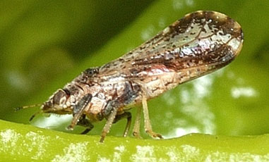
Citrus Greening Disease
Insecticide Program
ACP- June 1998, Greening– August 2005
UF/IFAS Citrus Extension
Citrus Health Management Areas (CHMAs) are grouping of commercial citrus groves in close proximity where growers coordinate Asian citrus psyllid control sprays to provide long-lasting effective psyllid
control to minimize movement of psyllids
between groves. Grower participation in
a CHMA is voluntary. (2011)

Slide 11
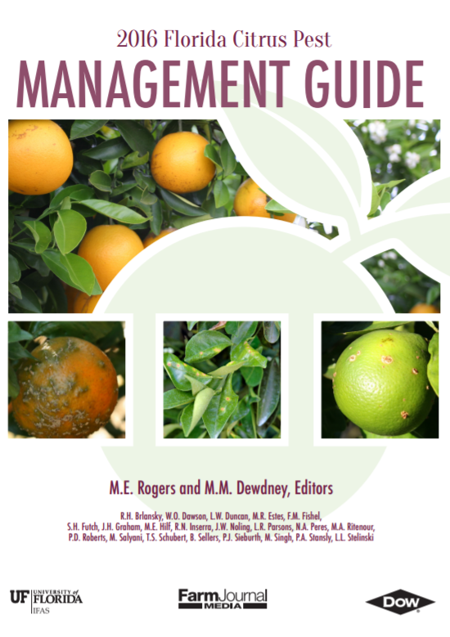
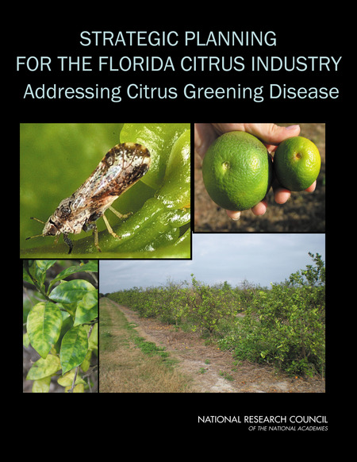
Original publication: December 1999
Committee on the Strategic Planning for the Florida, Citrus Industry, National Research Council, National Academy of Sciences. (2010)

Slide 12
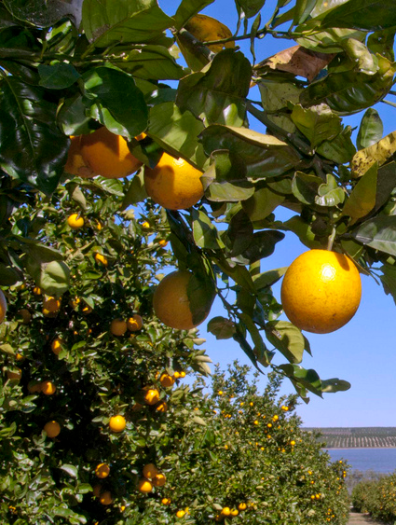
Citrus Greening Disease IPM
Tree Removal
Ensure infected trees will not serve as a source inoculum
Pruning of symptomatic branches is not successful
Propagation
Use clean bud wood, certified healthy trees
Purchase trees from a certified nursery
Scouting
Methods, frequency
Safety in the field
Asian Citrus Psyllid Management
Biological control
Area wide spay programs through CHEMAs
Speed sprayer and aerial application
Alternate Host Plants
Orange jasmine
Box orange, etc.
Antibacterial Management
Antibacterial Products
Crisis Declaration

Slide 13
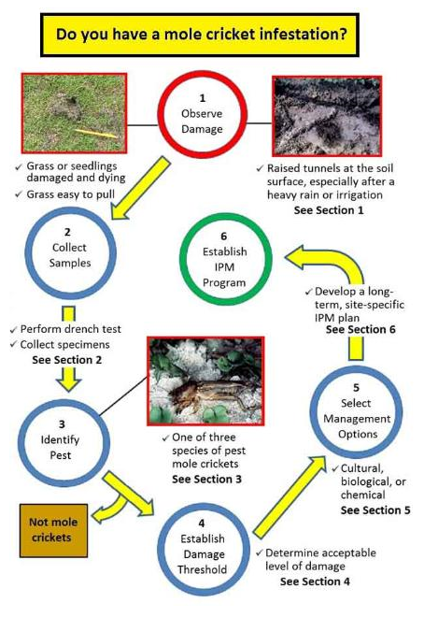
EDIS IPM-206 Mole Cricket IPM Guide for Florida
http://edis.ifas.ufl.edu/in1021

Slide 14
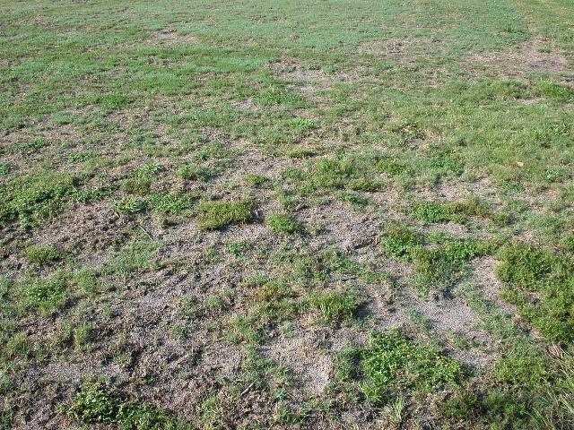
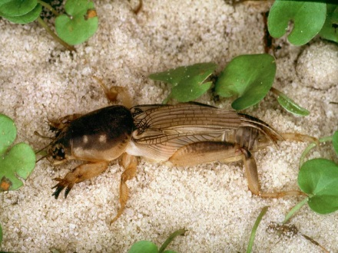
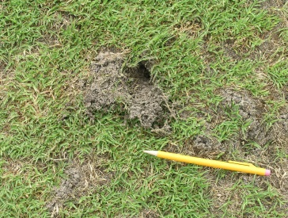
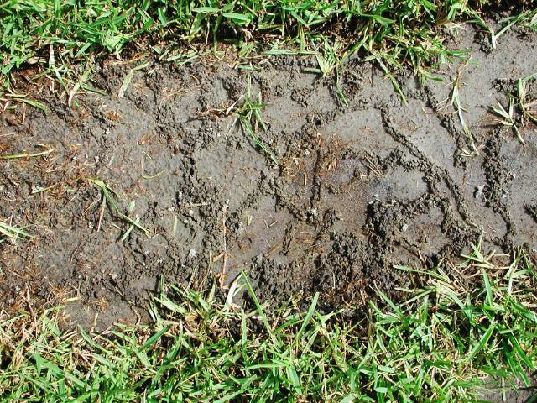
Section 1: Observe Damage
E. A. Buss, UF/IFAS

Slide 15
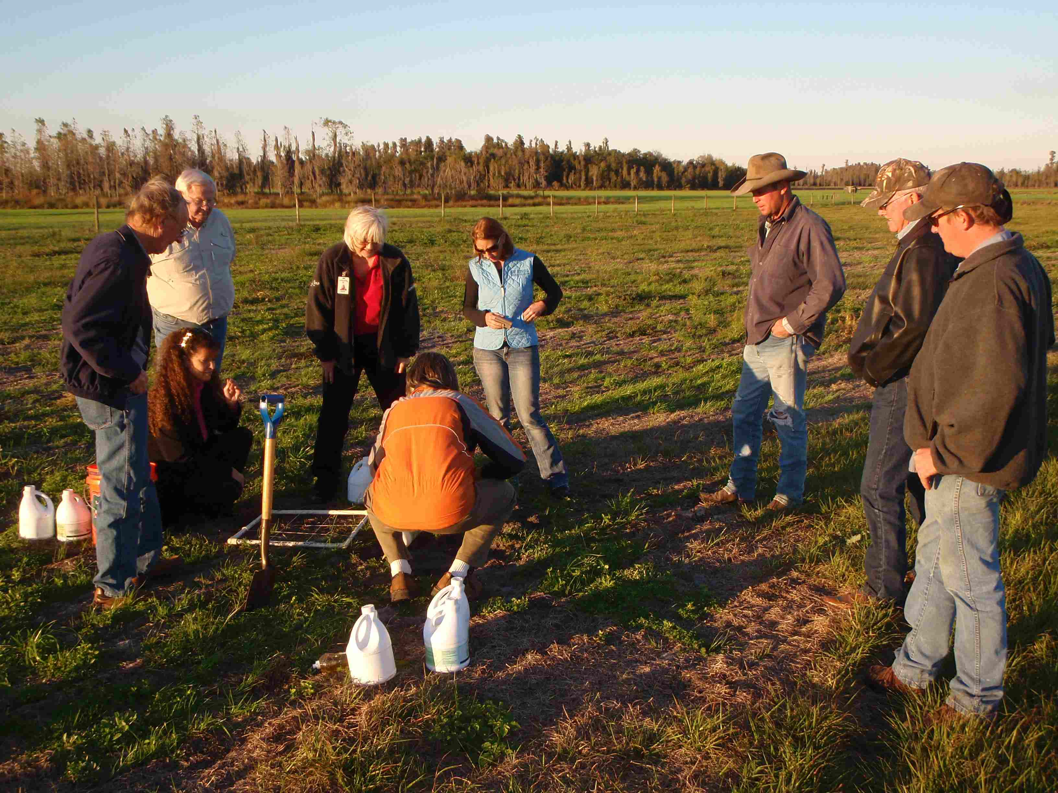
Section 2: Collect Samples

Slide 16
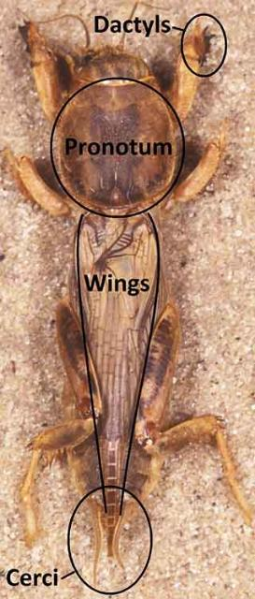
Section 3: Identify Pest
Tawny mole cricket
Scapteriscus vicinus
Southern mole cricket
Scapteriscus borellii
Shortwinged mole cricket
Scapteriscus abbreviatus

Slide 17
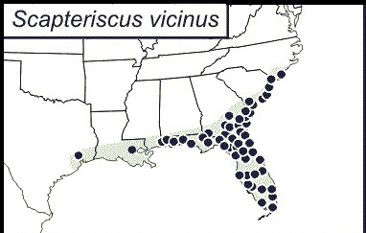
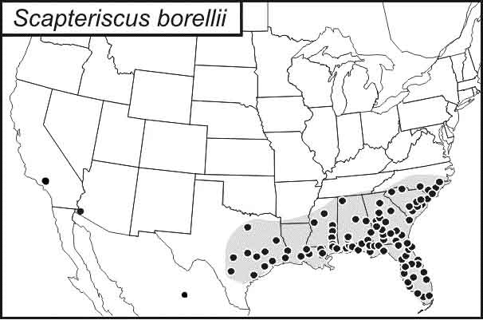
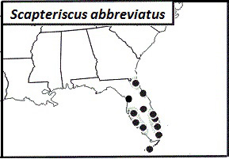
Pest Mole Cricket Geographical Distribution
T. Walker, UF/IFAS

Slide 18
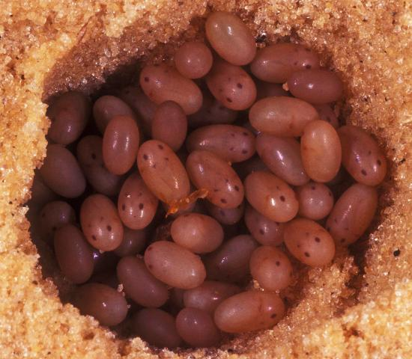
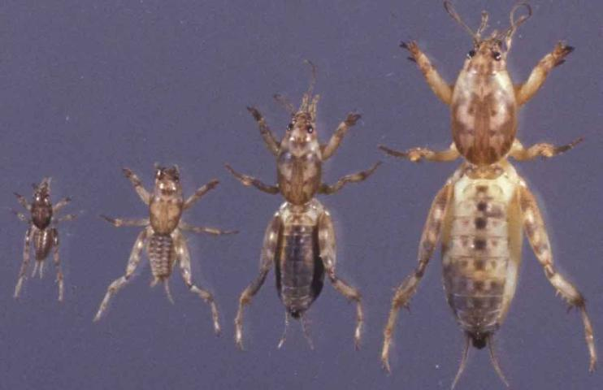
Mole Cricket Stages
of Development
L. Buss, UF/IFAS
J. Castner, UF/IFAS

Slide 19
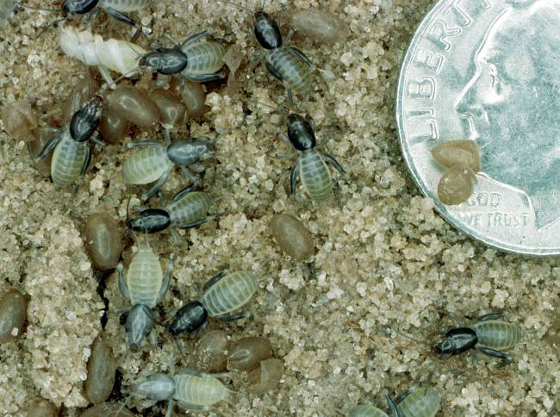
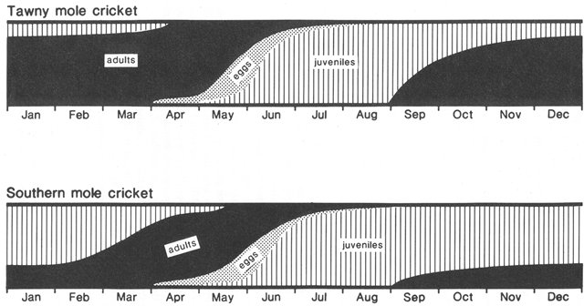
Seasonal Distribution of Mole Cricket Stages

Slide 20
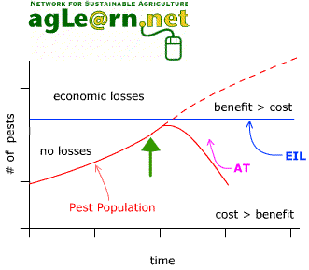
Section 4: Establish
Damage Threshold
General upper limit warranting management action for turf- 4 adult mole crickets per 4 ft², somewhat higher for pastures

Slide 21
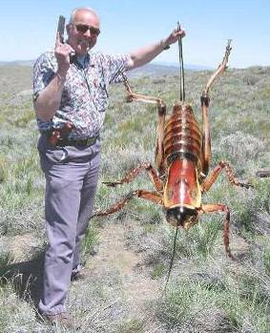
Section 5: Select Management Options
Cultural control
Tolerant cultivars
Soil moisture
Lighting
Tillage
Plant health
Record keeping
Biological control
Chemical control

Slide 22
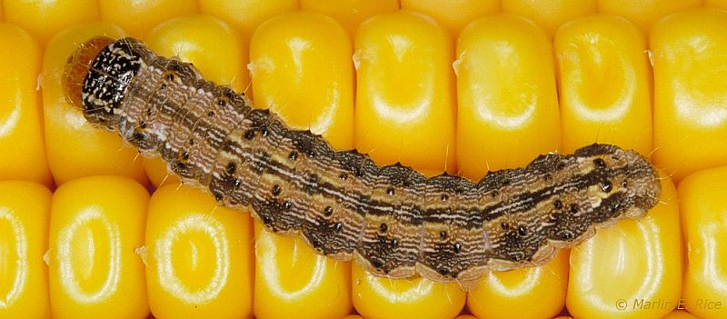
Choose Least-Risk Options
European corn borers can be managed in field corn with either insecticides or Trichogramma brassicae. Similarly, two-spotted spider mites can be managed in strawberry by applying miticides or predaceous mites. What factors cause a grower of corn or strawberries to choose chemical or biological control?
Pioneer

Slide 23
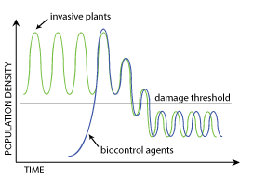
Biological Control Concept
Invasive pest
Population level
Action threshold
Biocontrol agent
Time

Slide 24
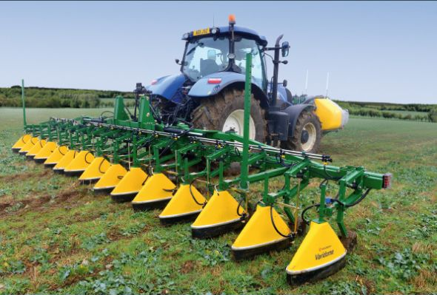
Insecticides
You have been using an insecticide successfully to manage an insect pest that lives in the soil but you notice that the product is no longer as effective. What kinds of changes might have occurred to render this insecticide ineffective? What actions might you take to restore its effectiveness?
G. A. Matthews

Slide 25
Pesticide Resistance Management
Pesticide resistance management is part of IPM- resistant crop varieties, competitors and natural enemies, monitoring, sanitation, crop rotation, adjacent crops and weeds, pesticides, and avoiding continuous year-round cultivation of a single crop.
Determine the presence and status of pests in the crop- ID, population dynamics (stages), abundance, thresholds.
Apply pesticides- selection, rates, application coverage, timing, frequency, rotation, mixtures, resistance monitoring, biopesticides.
Develop and refine a resistance management plan with stakeholders (growers, crop advisors, pesticide suppliers).

Slide 26
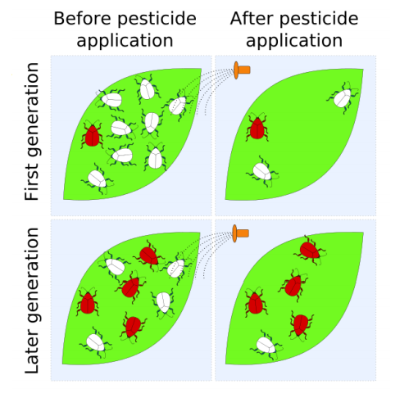
Pesticide Resistance Management
Pesticide resistance is a genetic change in an organism in response to selection by the toxicant.

Slide 27
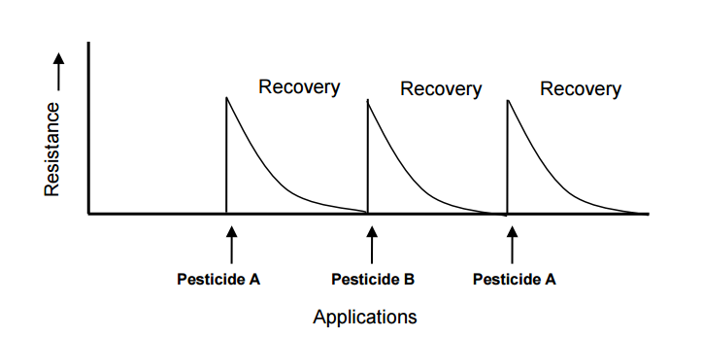
Resistance Levels and Pesticide Rotation
Effectiveness
Guidelines on Prevention and Management of Pesticide Resistance
http://www.eppo.int/PPPRODUCTS/resistance/FAO_RMG_Sept_12.pdf

Slide 28
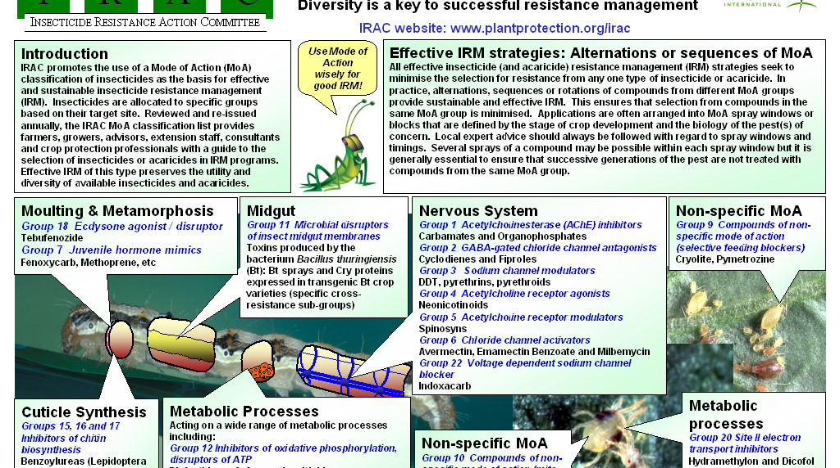

Slide 29
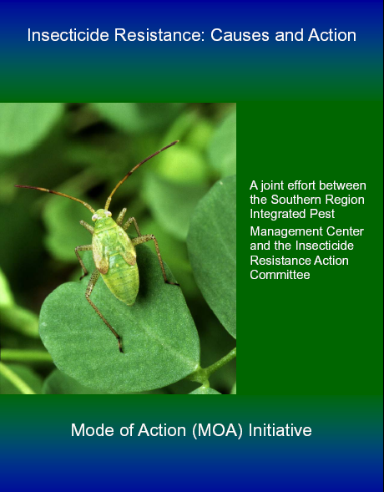
Pesticide Resistance
IRAC
HRAC
FRAC
Fred Fishel (University of Florida)
EDIS- http://edis.ifas.ufl.edu/pdffiles/PI/PI12100.pdf
Principles of Pesticides- http://agronomy.ifas.ufl.edu /pdfs/syllabi/ipm5305.pdf
Alan Roe (Utah State University)
http://utahpests.usu.edu/ipm/files/uploads/pptdocs/05sh-pesticides-new.pdf

Slide 30
IRAC Insecticide Classification
Acetylcholine esterase inhibitor (Carbamates, Carbaryl; Organophosphates, Malathion)
GABA-gated chloride channel antagonists (Cyclodiene organochlorines, chlordane; Phenylpyrazoles, Fipronil)
Sodium channel modulators (Pyrethroids, Pyrethrins, Bifenthrin; DDT, Methoxychlor, DDT)
Nicotinic Acetylcholine receptor agonists (Neonicotinoids, Imidacloprid; Nicotine Nicotine; Sulfoxaflor, Sulfoxaflor
Nicotinic Acetylcholine receptor allosteric activators (Spinosyns, Spinosad)
Chloride channel activators (Avermectins, Abamectin; Milbemycins)
Juvenile hormone mimics (Juvenile hormone analogues, Methoprene, Fenoxycarb, Pyriproxyfen)
Miscellaneous nonspecific (multi-site) inhibitors (Alky halides, Methyl bromide, Chloropicrin, Sulfuryl fluoride)
Selective homopteran feeding blockers (Pymetrozine, Flonicamid)
Mite growth inhibitors (Clofentezine)
Microbial disruptor of insect midgut membranes (Bacillus thuringiensis and the insecticidal proteins they produce; Bacillus sphaericus)
Inhibitors of mitochondrial ATP synthase (Diafenthiuron; Organotin miticides, Azocyclotin)
Uncouplers of oxidative phosphorylation via disruption of proton gradient (Chlorfenapyr; Sulfuramid)
Nicotinic acetylcholine receptor channel blockers (Nereistoxin analogues, Bensultap)
Inhibitors of chitin biosynthesis, type 0 (Benzoylureas, Diflubenzuron)
Inhibitors of chitin biosynthesis, type 1 (Buprofezin)
Moulting disruptor, Dipteran (Cyromazine)
Ecdysone receptor agonists (Diacylhydrazines, Tebufenozide)
Octopaminergic receptor agonists (Amitraz)
Mitochondrial complex III electron transport inhibitors (Hydramethylnon)
Mitochondrial complex I electron transport inhibitors (METI acaricides and insecticides, Fenpyroximate, Rotenone)
Voltage-dependent sodium channel blockers (Indoxacarb)
Inhibitors of acetyl CoA carboxylase - Lipid synthesis, growth regulation (Tetronic and Tetramic acid derivatives, Spirotetramat)
Mitochondrial complex IV electron transport inhibitors (Zinc phosphide, Cyanide)
Mitochondrial complex II electron transport inhibitors (Beta-ketonitrile derivatives, Cyenopyrafen)
Vacant
Vacant
Ryanodine receptor modulators (Diamides, Chlorantraniliprole)
(UN) Compounds of unknown or uncertain mode of action (Azadirachtin, Azadirachtin; Cryolite, Cryolite)

Slide 31
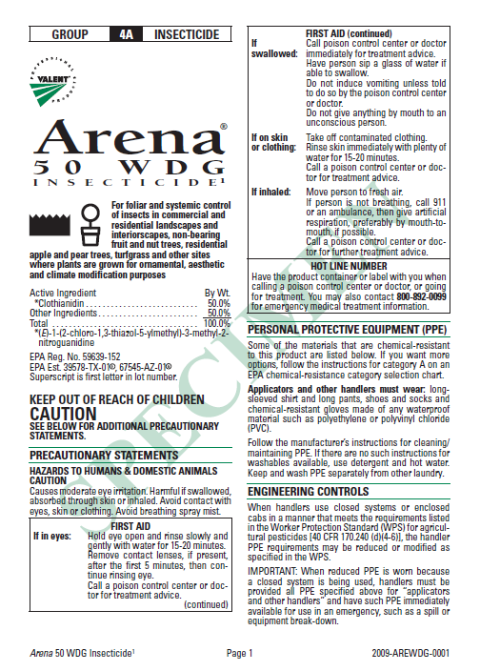
Pesticide Label
USER SAFETY RECOMMENDATIONS
Environmental Hazards
Directions for Use
AGRICULTURAL USE REQUIREMENTS
NON-AG USE REQUIREMENTS
LIMITED WARRANTY AND LIABILITY
RISKS OF USING THIS PRODUCT
RESISTANCE MANAGEMENT
RESTRICTIONS AND LIMITATIONS
Plant tolerance
Mixing instructions
Spray drift management
APPLICATION PROCEDURES
RESTRICTIONS AND LIMITATIONS
APPLICATION ON PLANTS FOR PESTS
STORAGE AND DISPOSAL

Slide 32
The Label is the Law
A landscape manager is having a major problem controlling grubs in customer’s lawns. A trade magazine advertisement recommended a new insecticide for grub control in turf. A colleague who was responsible for managing grubs at a turf farm tried the insecticide and it worked well. However, the insecticide was registered for use in turf production but not landscape maintenance. What would be required to use the insecticide legally?

Slide 33
Pesticide Information
UF/IFAS Pesticide Information Office- Dr. Fred Fishel
NPIRS- National Pesticide
Retrieval System
CDMS- ChemSearch
CDMS- http://www.cdms.net/
LabelsMsds/LMDefault.aspx
EPA- http://www.epa.gov/ opp00001/regulating/
registering/data_sources.htm
Extension Pesticide Applicator Training

Slide 34
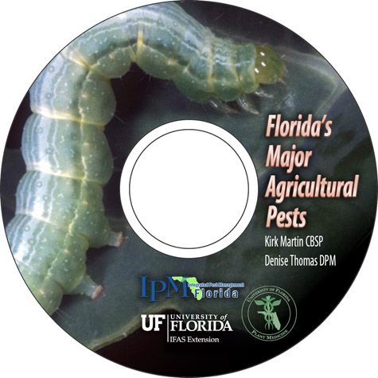
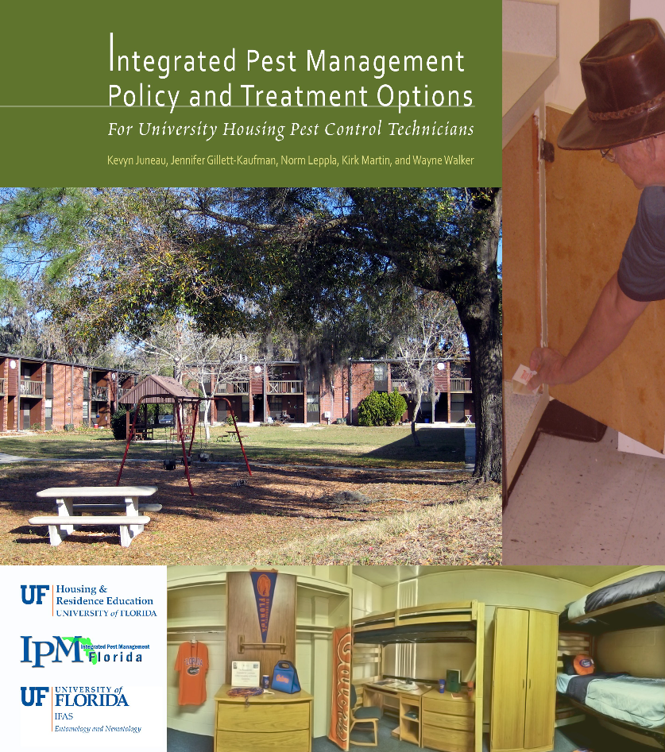
Extension Guides

Slide 35
Electronic Data Information Source (EDIS)
Agriculture
Community Development
Environment
Families & Consumers
4H Youth development
Lawn & Garden
Aquaculture
Crops
Livestock
Nursery & GH
Organic farming
Agricultural safety
Small farms
Turf & sod
http://edis.ifas.ufl.edu/

Slide 36
Featured Creatures provides in-depth profiles of insects, nematodes, arachnids and other organisms. The site is a cooperative venture of the University of Florida's Department of Entomology and Nematology and the Florida Department of Agriculture and Consumer Services' Division of Plant Industry. All articles are official publications of the University of Florida's Institute of Food and Agricultural Sciences.
 |  | or

Slide 37
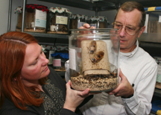
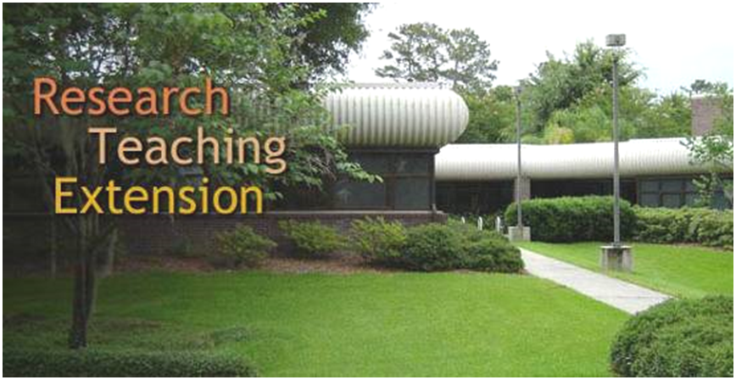
Urban Pest Management
(Urban IPM)- Dr. Phil Koehler

Slide 38
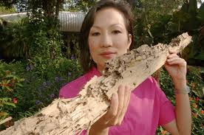
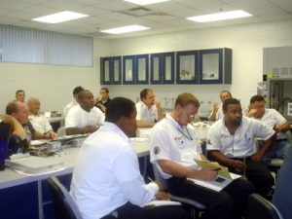
Dr. Faith Oi
Termite Training
General Household Pest (GHP) Training
Landscape & Ornamental (L&O) Pesticide Training
http://pmu.ifas.ufl.edu/

Slide 39
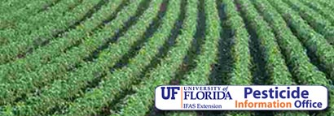
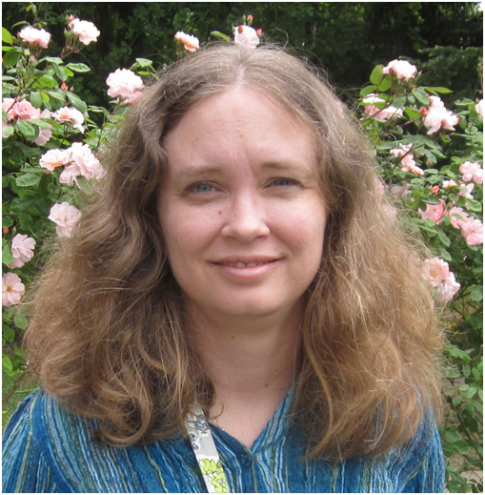
Dr. Amanda Hodges, Director

Slide 40
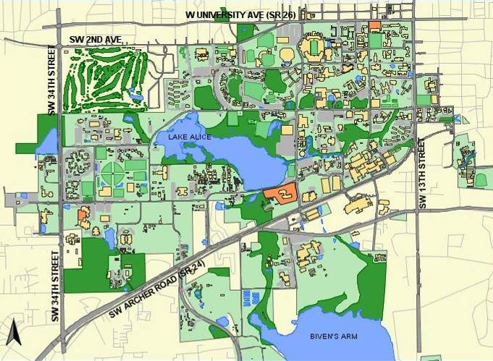
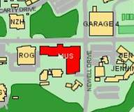
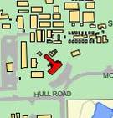
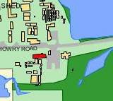
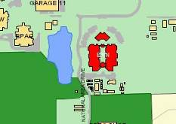
Plant Identification
Extension Soil Testing Lab
Plant Disease Clinic & Nematode Assay Lab
Insect Identification Lab

Slide 42
IPM Florida provides statewide, interdisciplinary and inter-unit coordination and assistance for UF/IFAS integrated pest management research Extension and education faculty
http://ipm.ifas.ufl.edu

